Slide 1

Pb²
Typing assistant for browsers

Slide 2
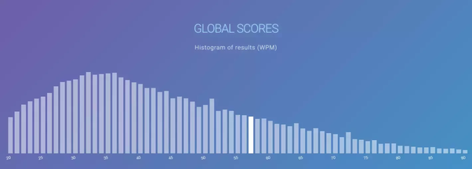
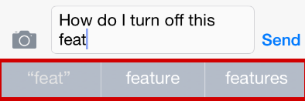
The World Needs a Writing Assistant
Notes:
Pre: Transition, We Want to fill a problem
First Click
Average typing speed in the US 40 WPM
Limits ability to use computer
Creates a gulf among users
Browsers are the hub of modern computer use
Next Click:
Phone Companies have already Identified this problem
Helped make the phone the most popular computer
Make it easier to use computers

Slide 3
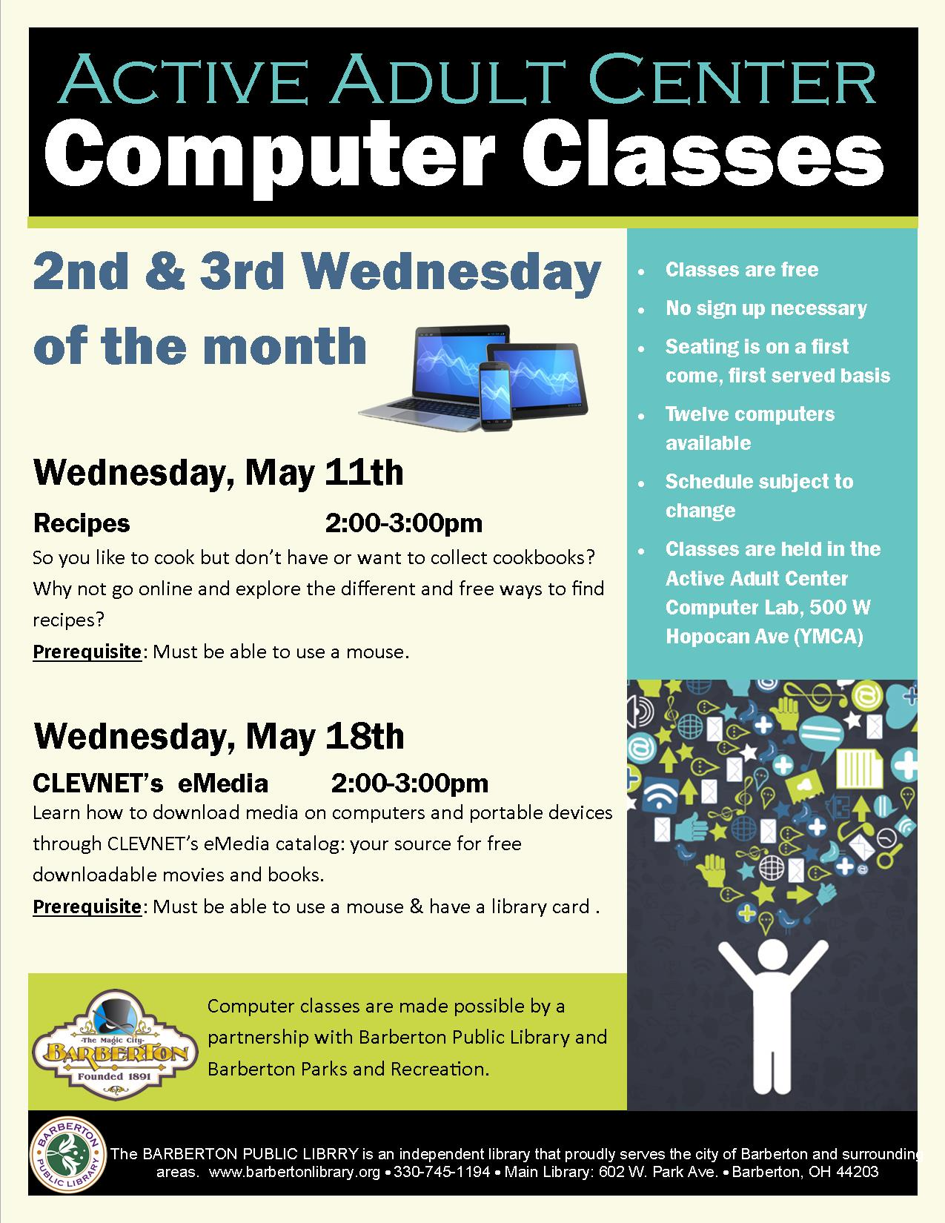
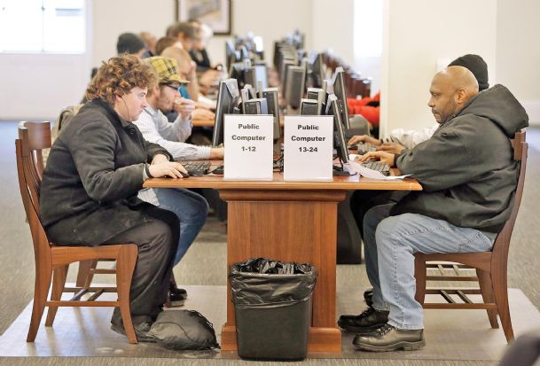
Client: The Public Library
Notes:
Pre click:
Transition
First Click:
Has a large proportion of inexperienced computer users Use computers in a time sensitive manner
Next Click:
Wants Speed up ability to type on browsers An intuitive format reminiscent of phones Cleanly incorporate into browsers Filter profanity

Slide 4

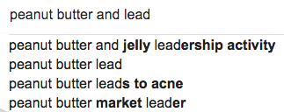
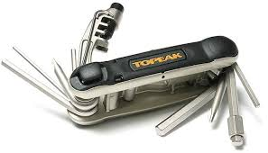
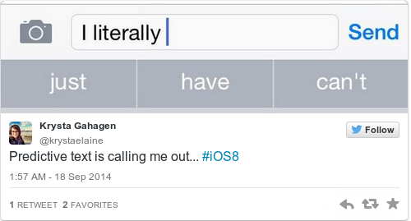
What we will achieve
A multifaceted typing assistant
Notes:
First Click: Predict the Next Phrase
Next Click: Predict the next word
Next: Import into browsers
Next: Add Tools as needed
Next: To Crate a

Slide 5
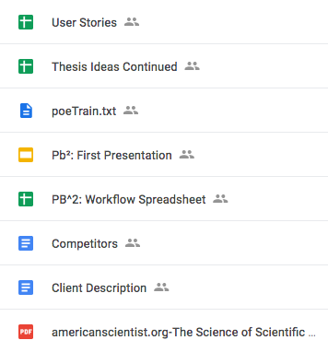
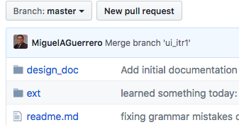
Recording and Repository
Notes:
First Click: Google Drive Spreadsheet to track decision Presentation and report files Easy to perform small edits
Github Code and other related files Version control

Slide 6
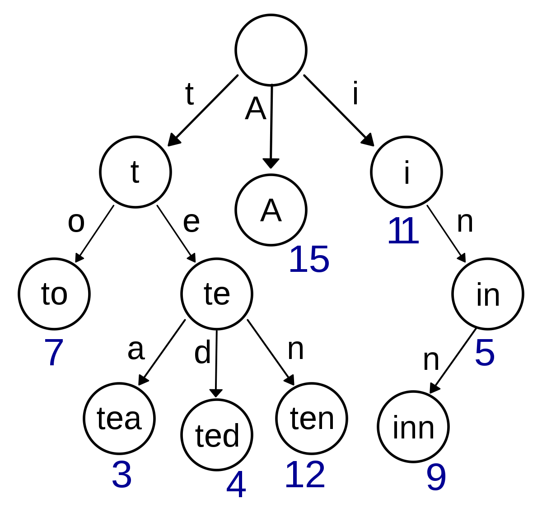
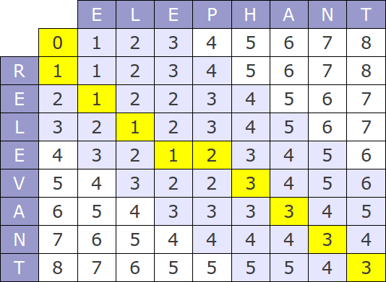
Current Word Completion: Levenshtein/Trie algorithm

Slide 7

Technical Details (Backend)
Next Word Prediction: Recurrent neural network

Slide 8



Frontend
Notes:
Created a Google Chrome extension using js
The testing framework in use is Jasmine
Chrome Extension cannot run node library

Slide 9
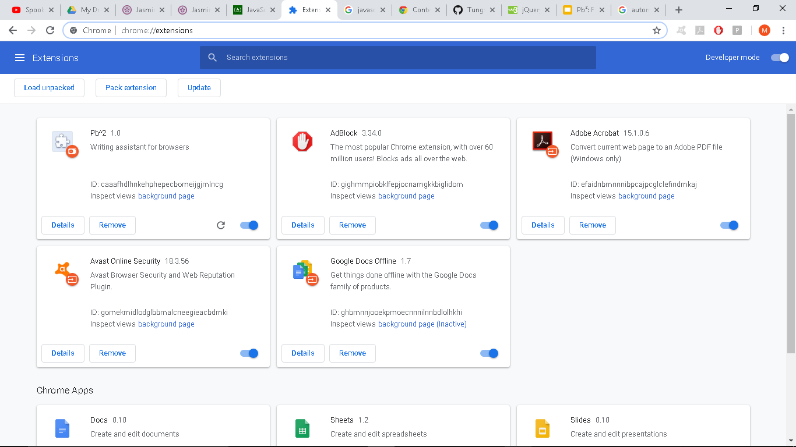

Slide 10
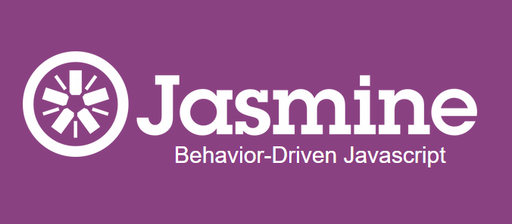
Frontend: Testing
Notes:
Jasmine testing frame work
Is Behavior Drivien Development oriented
Helps test JavaScript
Jasmine was easier to integrate than other frameworks (Mocha, Jest, etc.)

Slide 11
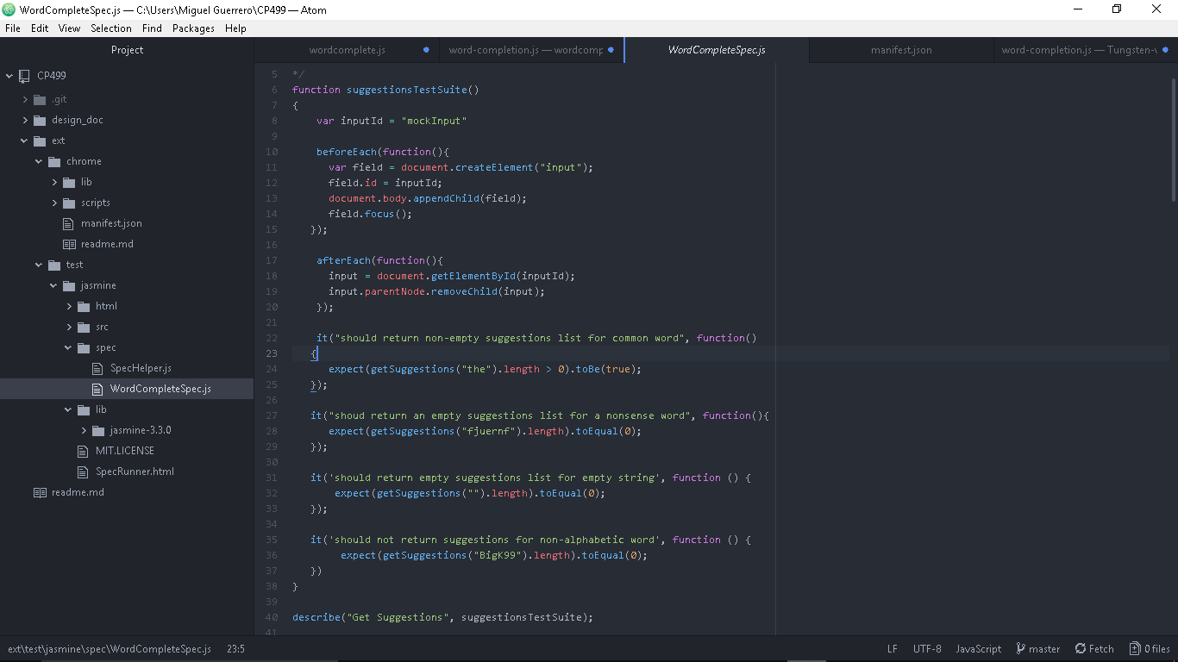
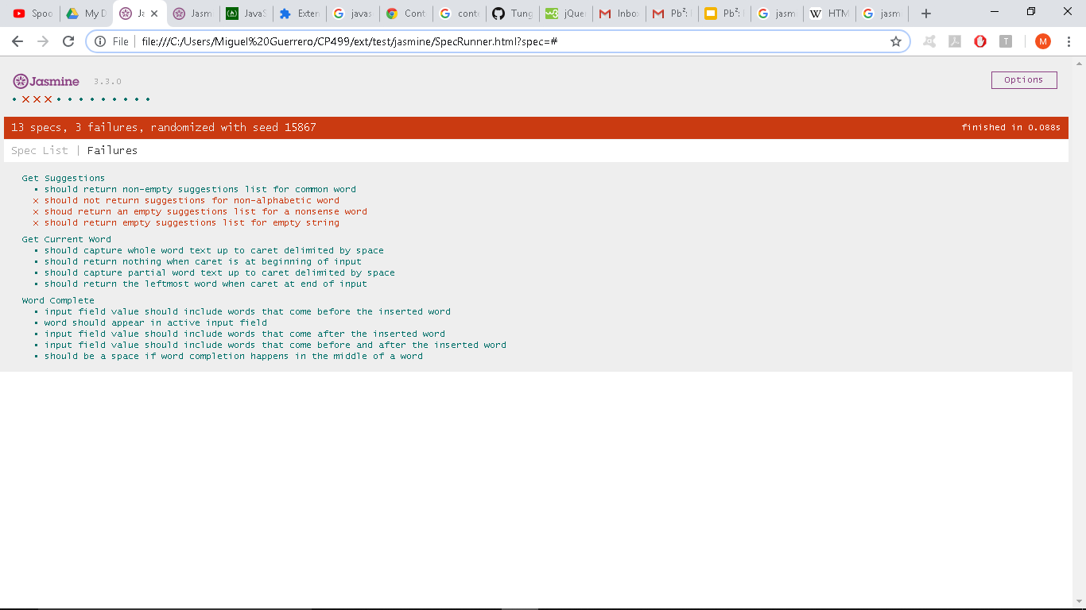
Frontend: Testing
Notes:
Features of the extension can be represented as tests
Each test represents a behavior of the app
Keeps us more focused on client’s need, and make it presentable to the client
Selenium for automated browsing?
Helps us with regression testing
Verify that models works
Important when we change models, which is expected
Highlight the fact that the test failed upon changing models and that this is why tests are useful

Slide 12
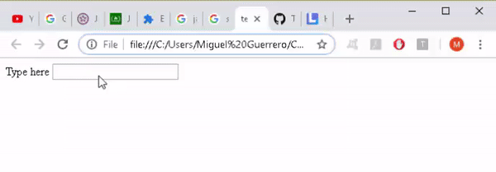
Demo
Suggestions are shown as users type
Notes:
Miguel Guerrero Tutorial
Suggestions are shown. It shows the closest 3 correct words.

Slide 13
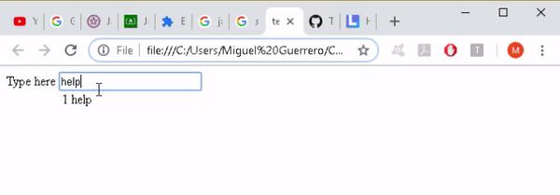
Demo
By pressing the displayed shortcut,
users can complete their words with the offered suggestions
Notes:
Pressing the number 1 can finish the word

Slide 14
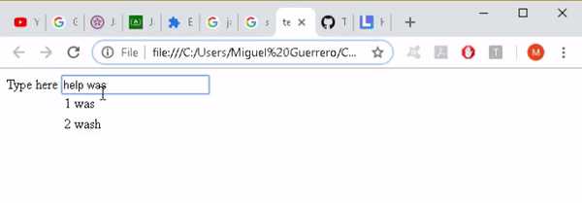
Demo
Suggestions are based on text up to the input cursor, delimited by whitespace
Notes:
Correct words in the middle. This expedited spelling changes

Slide 15
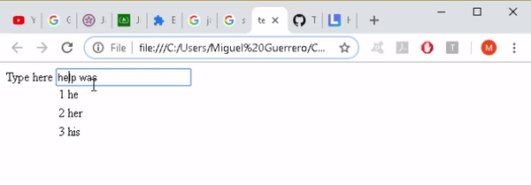
Demo
Word completion performed in the middle of text separates the trailing text with a whitespace.
Notes:
Currently

Slide 16


Challenges
Frontend
Backend
Notes:
Modules: The local modules are not the same as the Chrome modules: It's programming without being able to use imports
For Example: In current Incarnation
Oh tenser Flow. You are so strong. But much like the body builder in a horror film. Your just too big to make the cut. We spent many cold nights with you

Slide 17

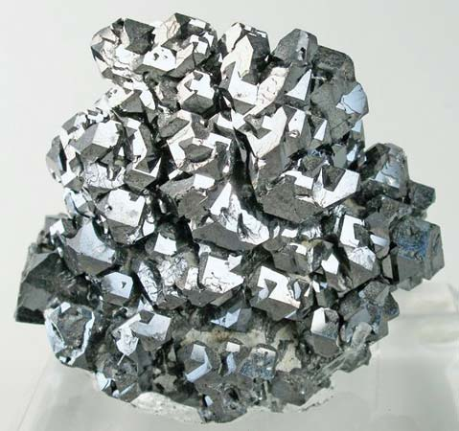
Plan & Goals
Week 1: fully integrated front and back end with both models
Week 2: client required features: profanity filter, erase search history (non-personalized), customizable word set
Week 3: polished final product, more models with greater capabilities
Notes:
A full set of goals can be Found on the google drive
Week 1 - fully integrated front and back end: We have two puzzle pieces that don't quite fit together. We need to sand them down until they fit.
Week 2 - client required features (profanity filter, erase search history (non-personalized), customizable word set)
Week 3 - polished final product, more models with greater capabilities. The goal of this project is to be easy. And you have spend a lot of hard work to make something feel easy.
I

Slide 18
Notes:
spent a significant portion of my fall break in a public library in Albaquerque New Mexico People watching. And for people coming to use the computers, Especially the elderly and the homeless. The keyboard wasn't a tool. It was an obsticle.
None of us expect that Pb2 is going to completely solve that problem. But It's going to make the whole computer expirience just a little bit easier. And isn't that the goal of software engineers everywhere.
To make the cold, hard, world a little bit easier.

Slide 19
Sources
Typing Speed Test
IPhone FAQ
Google
Stack OverFlow
The Columbus Dispatch
Mineral Education Coalition
TensorFlow
Ortus Solutions
Barberton Public Library

